Slide 1
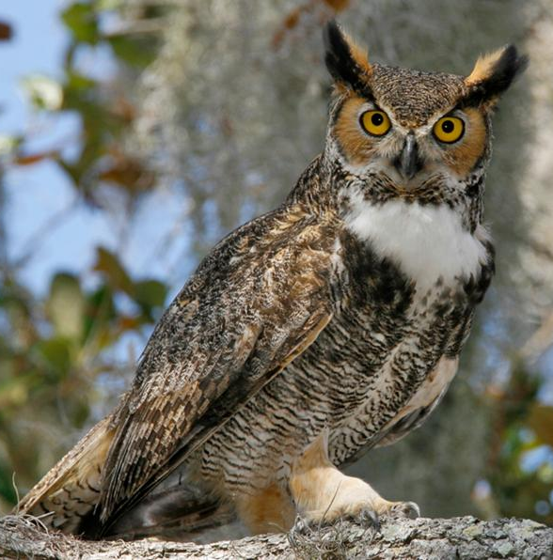
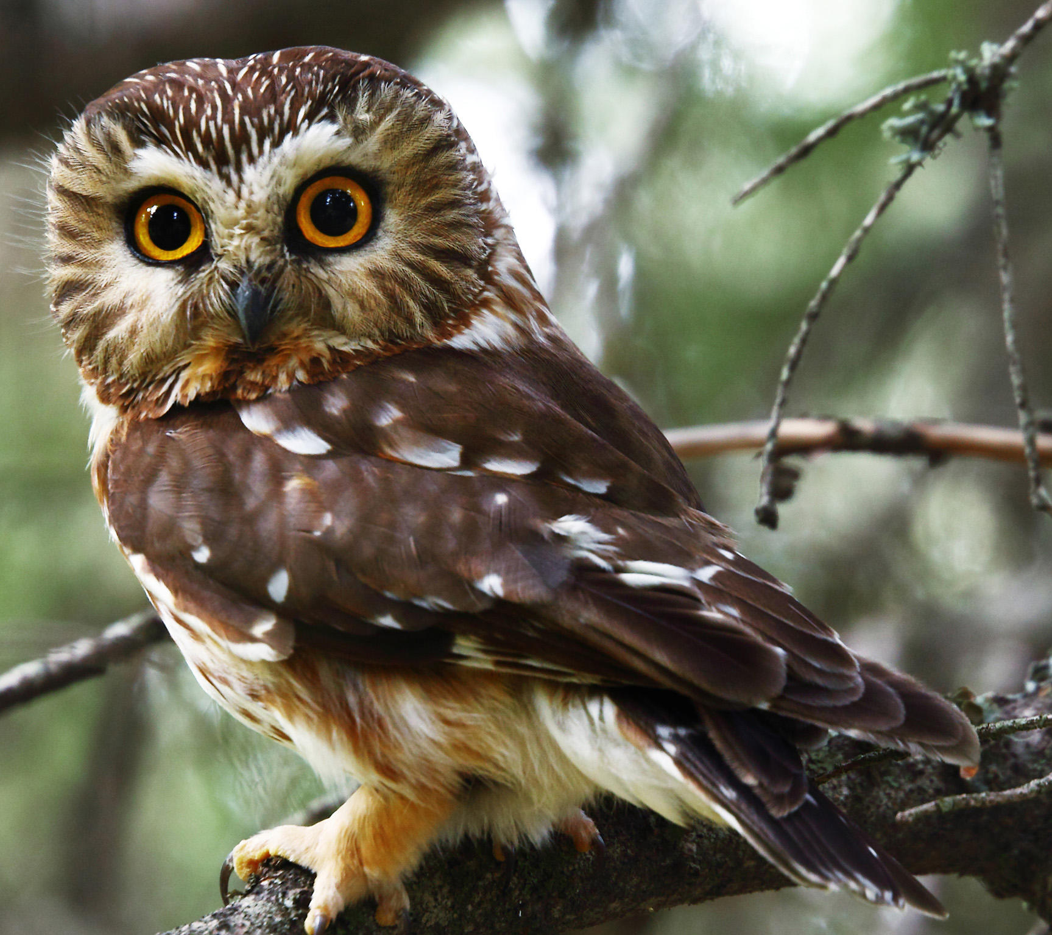
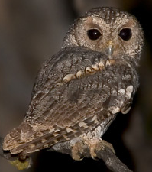
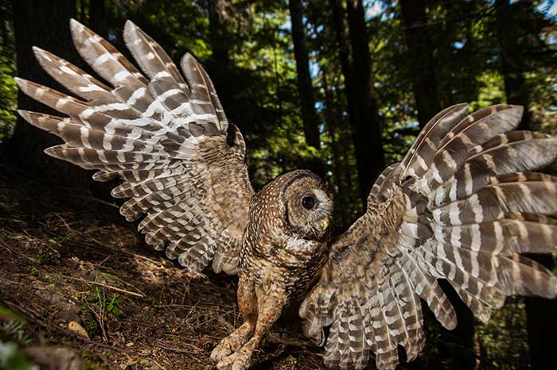
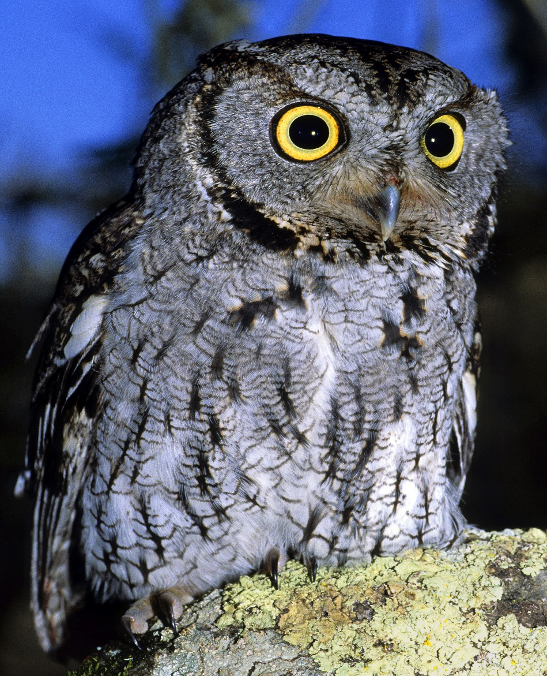
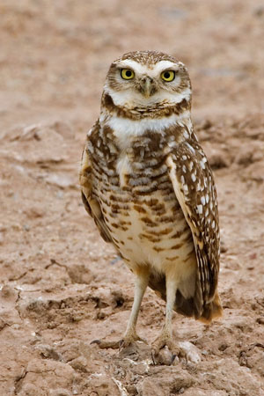
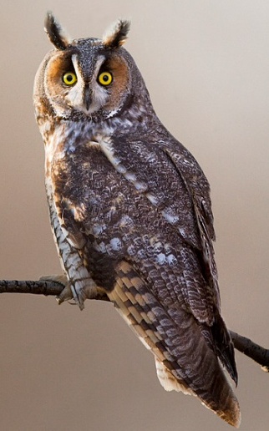
Santa Lucia Conservancy ~ Keeping it Wild
Owls of the Santa Lucia Preserve
1. Barn Owl
Around 16” high with a heart shaped face
Call: long hissing shriek “cssssshhhhH”
Feeds many young each year with small rodents
9. Great Horned Owl
The largest of the owls on The Preserve at 22”
Call: classic hooting “hoo-hoo-hoo”
Enjoys eating skunks and other small mammals
1.
8.
9.
2. Flammulated Owl
Less than 7” tall and notable dark eyes
Call: soft low “podo poot” repeated
Forages in the woods for insects
8. Northern Saw-Whet Owl
8” tall with a large fluffy head and white V on face
Call: low whistled “toit toit toit” repeated
Hunts for small mammals
2.
4.
7.
3. Western Screech Owl
Just over 8” tall and
variable in color
Call: short whistles like
a bouncing ball “pwep
pwep pwep”
Forages around forest edge for insects and small rodents
7. Northern Pigmy Owl
Less than 7” tall with long tail
Call: single or double “toots” monotonously
Hunts small birds during the day
3.
5.
6.
4. California Spotted Owl
17” tall with dark eyes
Call: barking hoot
“whup, hoo hoo”
Eats rodents and small
mammals in forested areas
6. Northern Long-Eared Owl
Just over a foot tall with prominent “ear” tufts
Call: single soft “wooip” repeated every 3 seconds
Hunts small mammals in brushy fields and woodland edges
5. Burrowing Owl
Around 9” tall with extra long legs
Call: high “coo-coooo”
Hunts small rodents in grasslands

